Slide 1
STUDYING NATURE’S MEDICINE IN OUR SCHOOL CAMPUS
Tanushree.U and Nithya.B of Class 8A
Affiliations : Friends and Classmates

Slide 2
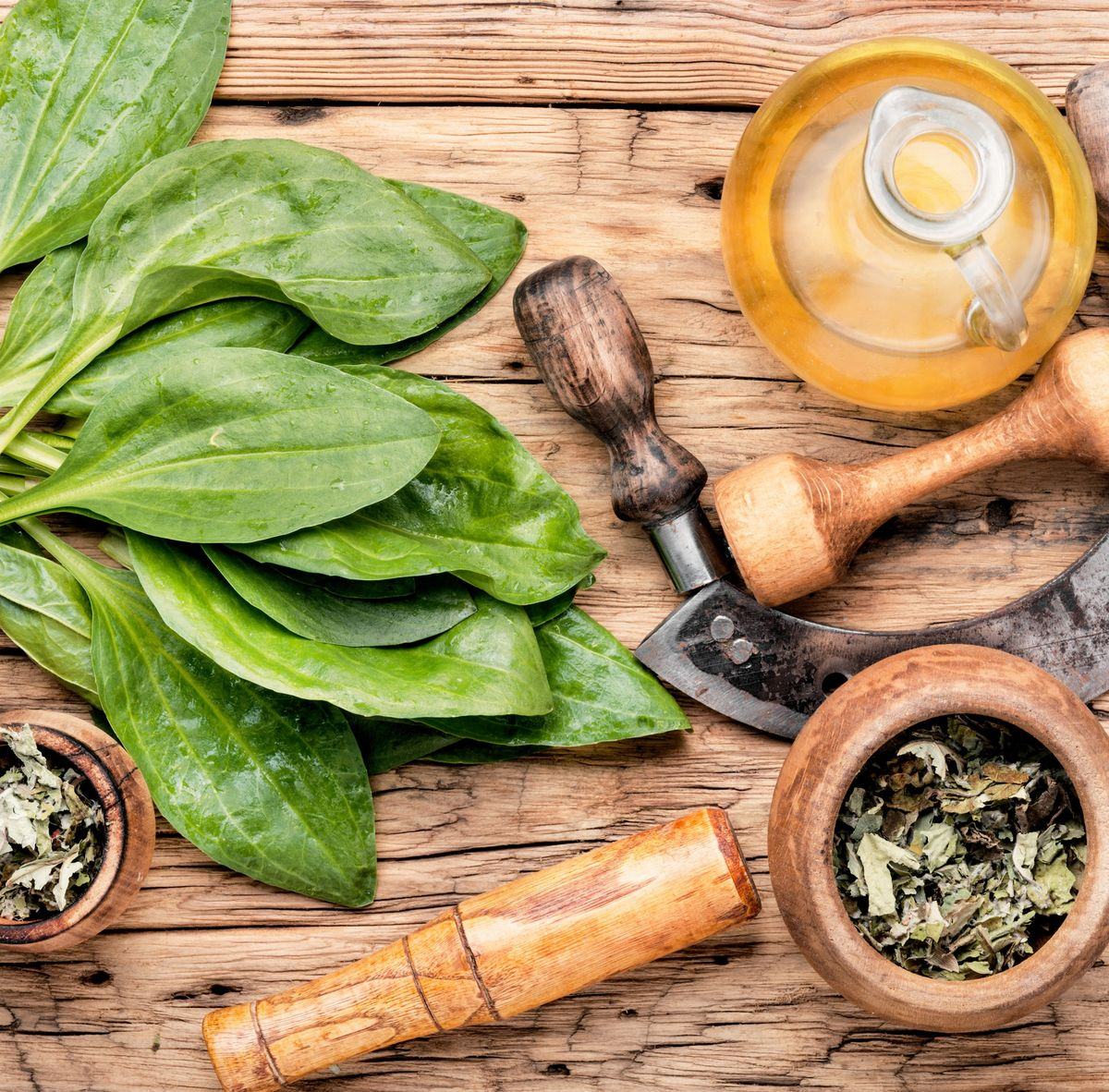
INTRODUCTION
Medicinal plants, also called medicinal herbs, have been discovered and used in traditional medicine practices since prehistoric times.
Medicinal plants are used with the intention of maintaining health, to be administered for a specific condition, in modern medicine or in traditional medicine.
Plant medicines can cause adverse effects and even death, whether by side-effects of their active substances, by adulteration or contamination, by overdose, or by inappropriate prescription

Slide 3
Objective
Our objective in doing this activity- Medicinal plants have a promising future because there are about half a million plants in the world. These plants are a potential source of bio-molecules that play a major role in modern medicine hence, we wanted to know about the sublime benefits that we could experience due to the medicinal benefits of plants found around us .
Plants synthesize hundreds of chemical compounds for various functions, including defense and protection against insects, fungi, diseases, and herbivorous mammals.

Slide 4
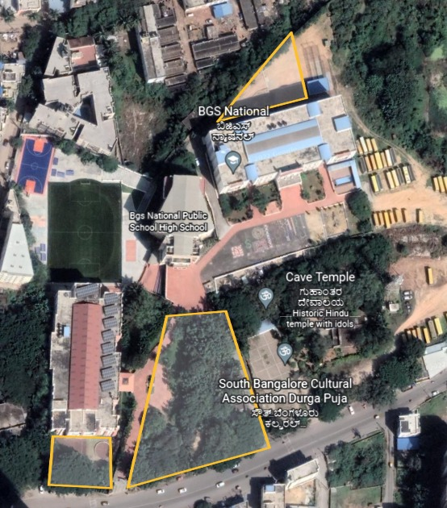
METHODS AND MATERIALS
Area of our study
Main Garden-12,52’37”N 77,35’55”E
Garden behind main block- 12,52’37”N 77,35’55”E
Garden behind PP block- 12,52’41”N 77.35’58” E

Slide 5
Materials we used:-
Logbooks
Reference books
Enquired home remedies from school aunties and helpers
Google forms
Wix website editor
Smartphones
Laptops

Slide 6
Result
Sl no | Scientific Name | Common Name | Kannada name | No. of plants in the school campus | Medicinal values
1. | Ocimum sanctum | Holy Basil | Rama Tulsi | 15 | treatment of colds and flue, to cleanse the respiratory tract of toxins, and in the relief of gas and bloating.
2. | Ocimum sanctum | Holy Basil | Krishna Tulsi | 22 | helps cure infections such as throat infections, respiratory problems, earaches and skin diseases.
3. | Curcuma longa | Wild turmeric | Harishina | 1 | anti-tumor, immunological effects, wound healing, anti -fungal, anti -oxidant, anti - microbial, anti-diabetic, antiplatelet and mosquito repellent activity

Slide 7
Sl no | Scientific name | Common name | Kannada name | No. Of plants in the school campus | Medicinal values
4. | Hemigraphis corolata | Tincher | Tincher | 3 | Reduce anxiety, treat epilepsy, and relieve pain
5. | Coleus amboinicus | Indian borage | Dodda patre | 9 | Fever, cough, and depression
6. | Eclipta prostrata | False daisy | Kesavardhini | 17 | Treat athlete's foot, dermatitis, eczema and many other underling skin conditions.
7. | Cymbopogon | Lemon grass | Nimbe hullu | 4 | Relieve pain and swelling, reduce fever, improve levels of sugar and cholesterol in the blood, stimulate the uterus and menstrual flow, and have antioxidant properties.

Slide 8
Sl no | Scientific name | Common name | Kannada name | No. Of plants in the school campus | Medicinal values
8. | Ribes uva-crispa | Gooseberry | Nelikayi | 4 | Lower blood sugar, cholesterol, and blood pressure levels, as well as a reduced risk of cancer, diabetes, heart disease, and age-related illnesses of the brain.
9 | Mangifera | Mango | Mavina gida | 7 | Treat anemia, cutaneous infections, diabetes, diarrhea, scabies, syphilis, and malignant tumors
10 | Clitoria | Butterfly pea | Girikarnike | 1 | Memory enhancer, nootropic, antistress, anxiolytic,anticonvulsant, tranquilizing and sedative agent.

Slide 9
Sl no | Scientific name | Common name | Kannada name | No. Of plants in the school campus | Medicinal values
11. | Catharanthus roseus | Vinca rosa | Sadapushpa | 4 | Cancer and diabetes
12 | Costus igneus | Insulin plant | Madumeha | 7 | Anti-cancer, anodyne, and it can reduce cholesterol, maintains kidney health, cure liver illness, boosts immunity, prevents cancer easily.
13 | Piper bettle | Bettle leafs | Veeledele | 2 | Analgesic, eases constipation, improves digestion, manages diabetes
14 | Justicia adhatoda | Vasaka | Adusogae | 2 | For cold, cough, bronchitis, asthma, breathing difficulties, sore throat, other respiratory diseases

Slide 10
Sl no | Scientific name | Common name | Kannada name | No. Of plants in the school campus | Medicinal values
15 | Psidium guajava | Guava | Seebehannu | 6 | Lowers cholesterol, manages diabetes, beats toothache
16. | Artocarpus heterophyllus | Jackfruit | Halasina hannu | 1 | Anti-oxidant, anti-inflammatory, antimicrobial, anti-cancer and anti-fungal activity.
17. | Ptilinopus jambu | Jambul trees | Jambu nerale | 1 | Cooling effect on the body.
18 | Hibiscus rosa-sinensis | Hibiscus | Daasavala | 12 | Hypertension, fever, colds, heart and nerve diseases, upper respiratory tract pain and swelling
19. | Musa | Banana | Balehannu | 1 | Treat ulcers, dysentery, and bronchitis
20. | Crocus sativus | Saffron | Kesari | 1 | Improve mood, reduced PMS symptoms and weight loss

Slide 11
Sl no | Scientific name | Common name | Kannada name | No. Of plants in the school campus | Medicinal values
21 | Chrysopogon zizanioides | Vetiver | Lavancha | 2 | Used as carminative, diaphoretic, refrigerant, stomachic, tonic, antispasmodic.
22 | Manilkara zapota | Sapodilla | Sapota | 3 | Keeps you regular, promotes feelings of fullness, and regulates blood sugar and cholesterol levels
23 | Moringa oleifera | Drum stick | Nugekayi | 1 | Protecting the liver from damage, oxidation and toxicity
24 | Morus alba | Mulberry | Heppunerale | 3 | Lower cholesterol levels, help prevent fatty liver disease, and improve blood sugar control.

Slide 12
Sl no | Scientific name | Common name | Kannada name | No. Of plants in the school campus | Medicinal values
25 | Oxalis latifolia | Broadleaf woodsorrel | Hullisoppu | Weeds | Anti-inflammatory,, anticonvulsant, antifungal, antiulcer, antinociceptive, anticancer, antidiabetic
26 | Taraxacum erythrospermum | Dandalions | Kadusewantige | Weeds | Highly nutritious, contains potent antioxidants. , Fight inflammation. Aid in blood sugar management
27 | Punica granatum | Pomegranate | Dalimbe | 4 | Preventing prostate, breast, lung, and colon cancers.
28 | Justicia adhatoda | Malabar nut | Adusoge | 2 | Treatments of cough, colds, asthma, to liquefy sputum, bronchitis, and tuberculosis

Slide 13
Sl no | Scientific name | Common name | Kannada name | No. Of plants in the school campus | Medicinal values
29 | Citrus limon | Lemon plant | Nimbe gida | 3 | Used to treat scurvy, a condition caused by not having enough vitamin C
30 | Magnolia champaca | Champak | Sampige | 4 | Useful in diabetes, quick wound healing, cardiac disorders, gout, dysuria and more.
31 | Azadirachta indica | Neem | Bevinamara | 2 | Anti-inflammatory, antihyperglycemic, antiulcer, antimalarial, antifungal, antibacterial, antiviral properties
32 | Aloe barbadensis miller | Aloe vera | Lolesara | 6 | Helps in acidity and bloating, clears toxins from the digestive system Improves the functioning of kidneys, liver, gallbladder

Slide 14
Sl no | Scientific name | Common name | Kannada name | No. Of plants in the school campus | Medicinal values
33 | Tabernaemontana | The pinwheelflower | Nag kuda | 2 | Anti-epileptic, anti-mania, brain tonic, and anti-oxidant.
34 | Zingiber officinale | Common ginger | Shunti | 1 | Treating headaches, indigestion, nausea, vomiting, and cancer
35 | Jasminum | Jasmin | Mallige | 1 | Used for liver disease ,pain due to liver scarring , and abdominal pain due to severe diarrhea
36 | Solanum melongena | Brinjal | Badnekayi | 1 | Help protect your cells against damage

Slide 15
Sl no | Scientific name | Common name | Kannada name | No. Of plants in the school campus | Medicinal values
37 | Tinospora cordifolia | 'Heart-leaved moonseed | Amruthabali | 2 | Anti stress, anti inflammatory, anti allergic, liver protective properties
38 | Chrysanthemum | Mums | Shavantige | 2 | Treat chest pain, high blood pressure, fever, cold, headache, dizziness, and swelling.
39 | Ocimum basilicum | Basil | Kamakasturi | 2 | Aids in lowering down the sugar in the blood.
40 | Allium tuberosum | Chives garlic | Beluli | 1 | Which prevents from common cold and fever
41 | Cissus quadrangularis | Veld grapes | Drakshi | 1 | Preventing diseases of the heart and blood vessels, varicose veins, hemorrhoids

Slide 16
Sl no | Scientific name | Common name | Kannada name | No. Of plants in the school campus | Medicinal values
42 | Persea americana | Butter fruit | Benne hannu | 3 | Improves digestion, prevents cancer, helps in weight loss and good for your heart
43 | Ixora coccinea | Ixora | Haladi kisukare | 2 | Antinociceptive, antimutagenic, antineoplastic and chemopreventive effects
44 | Gossypium | Cotton | Hatti | 1 | Used for nausea, fever, headache, diarrhea, dysentery, and nerve pain,
45 | Citrus sinensis | Orange | Kitalehannu | 1 | , Cough, cold, obesity, menstrual disorder, angina, hypertension, anxiety, depression and stress

Slide 17
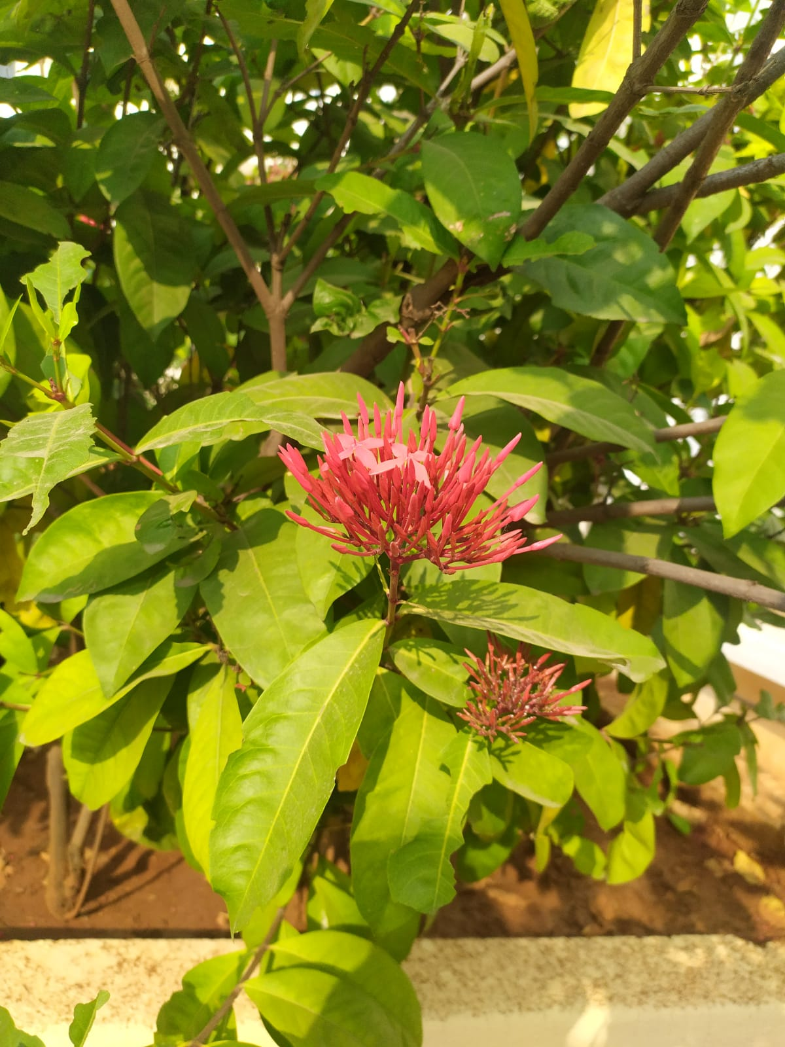
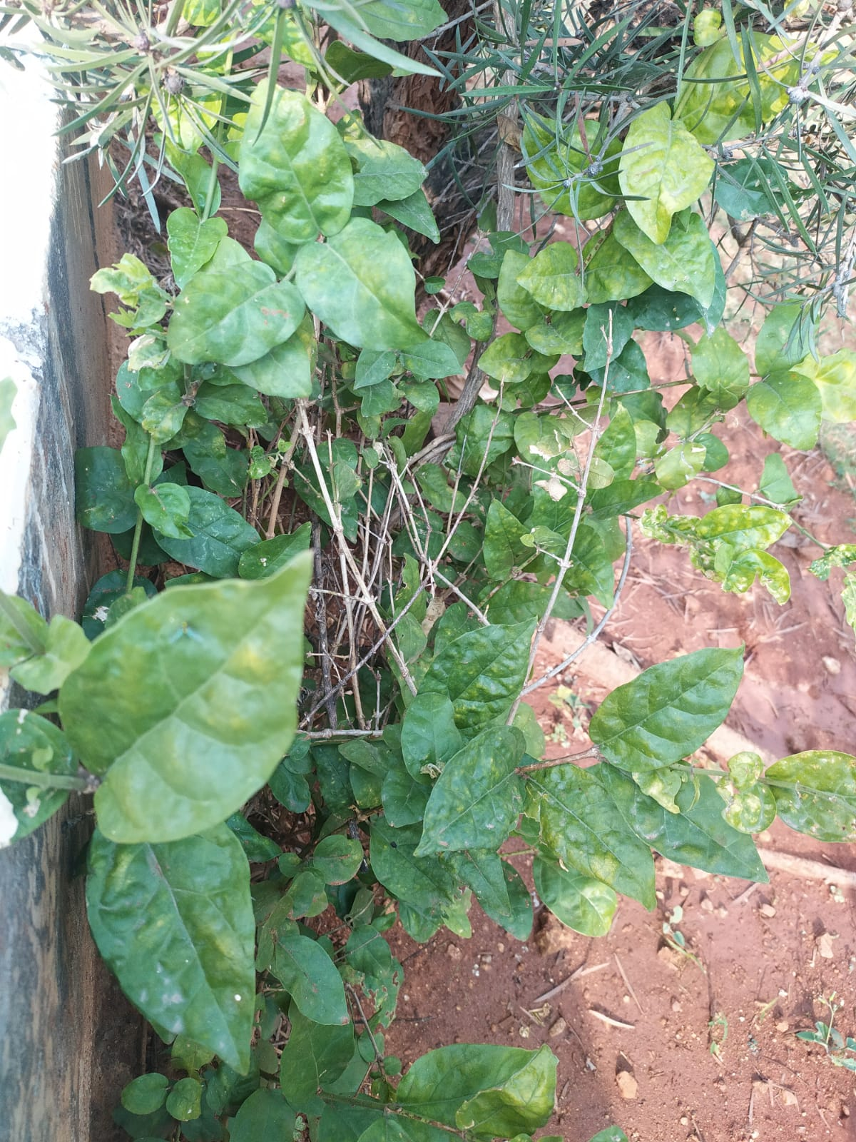
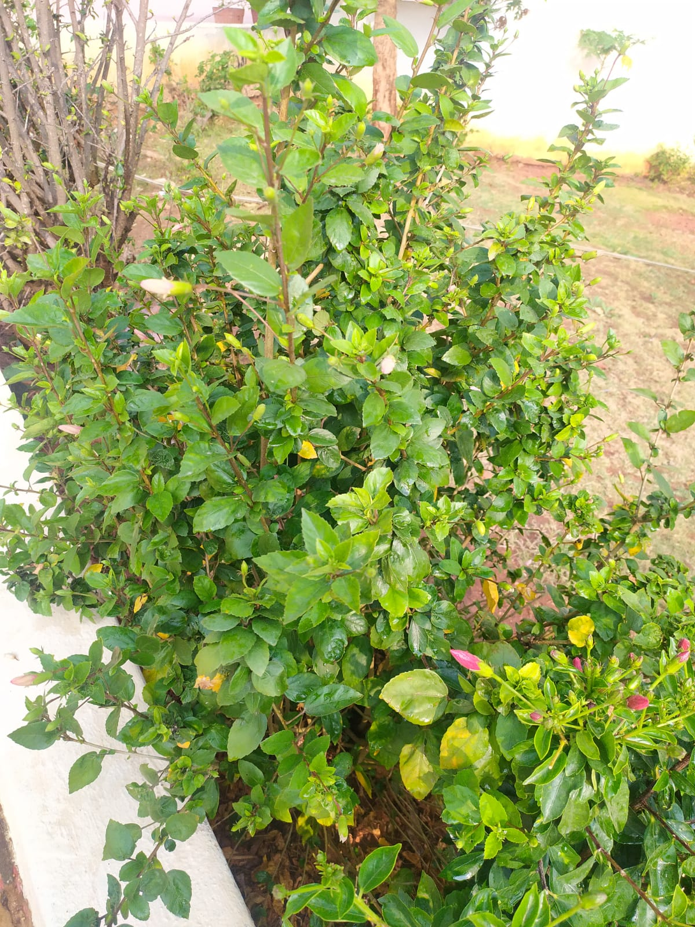
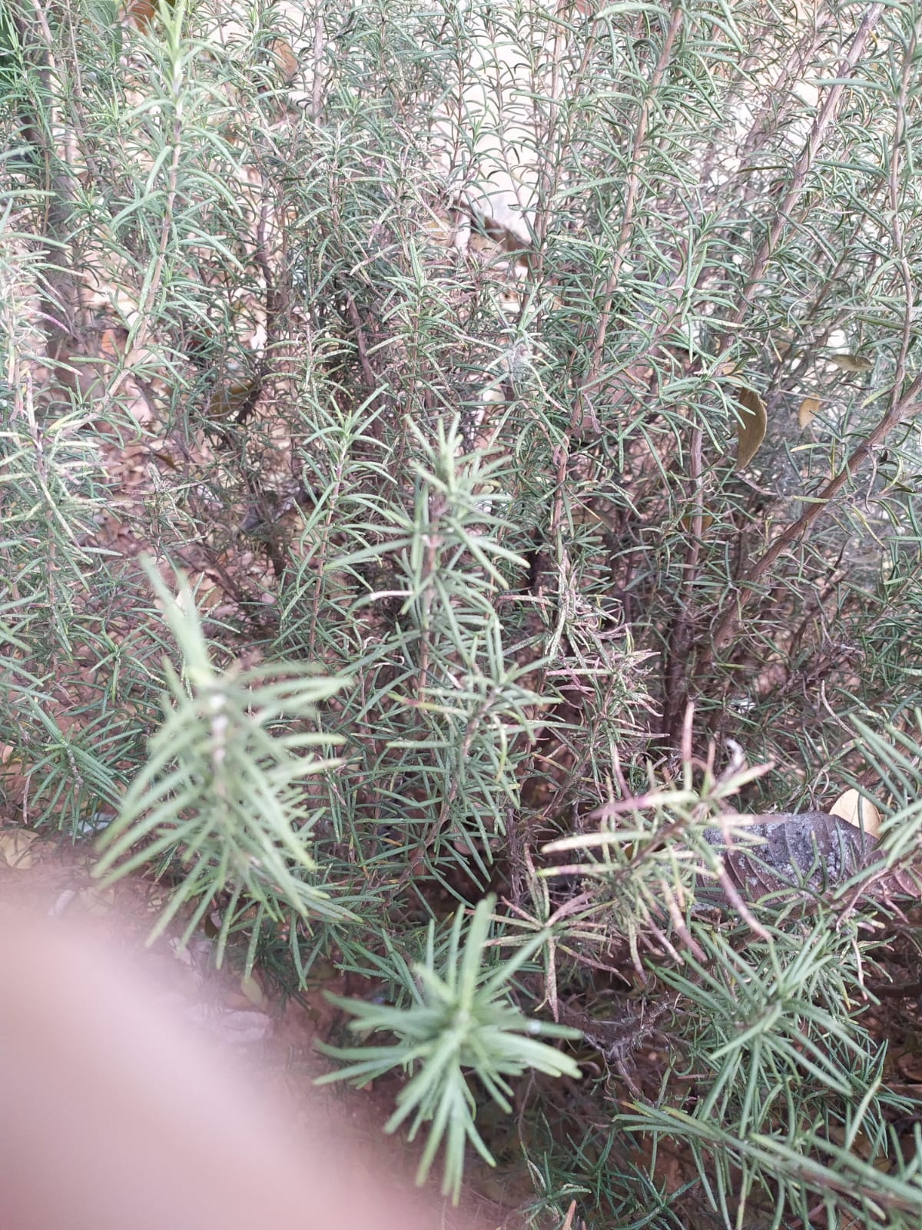
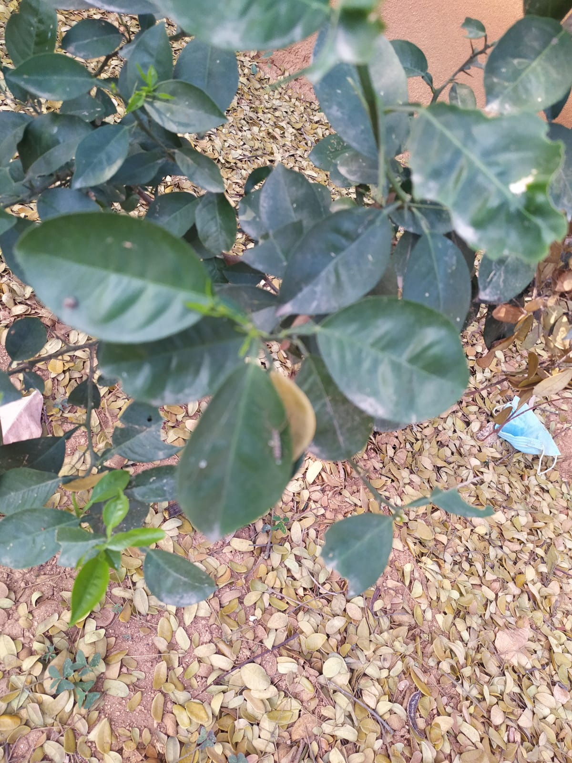
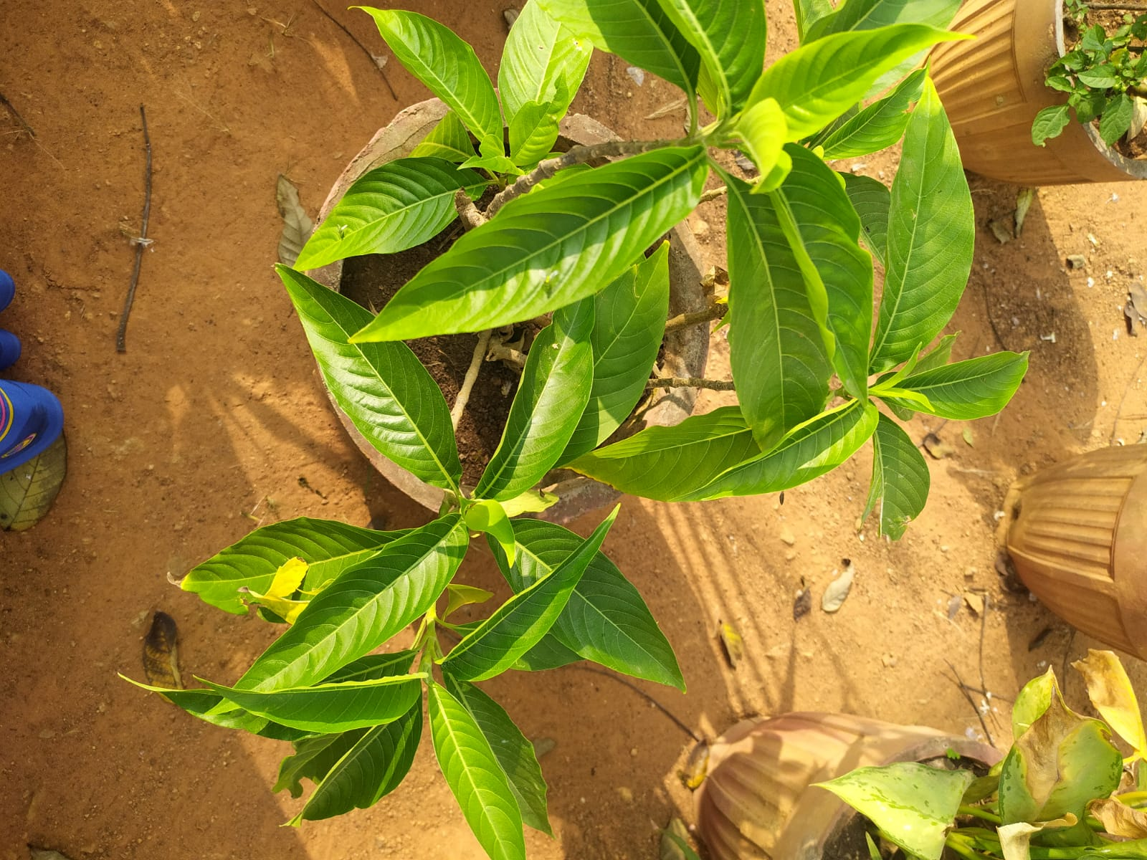
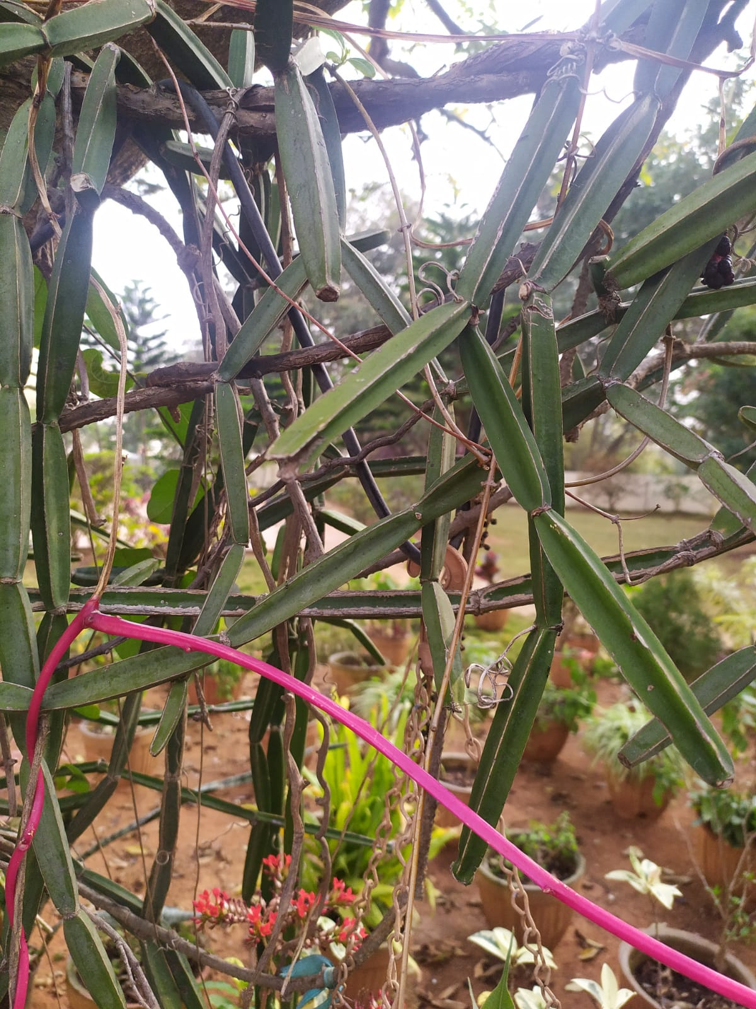
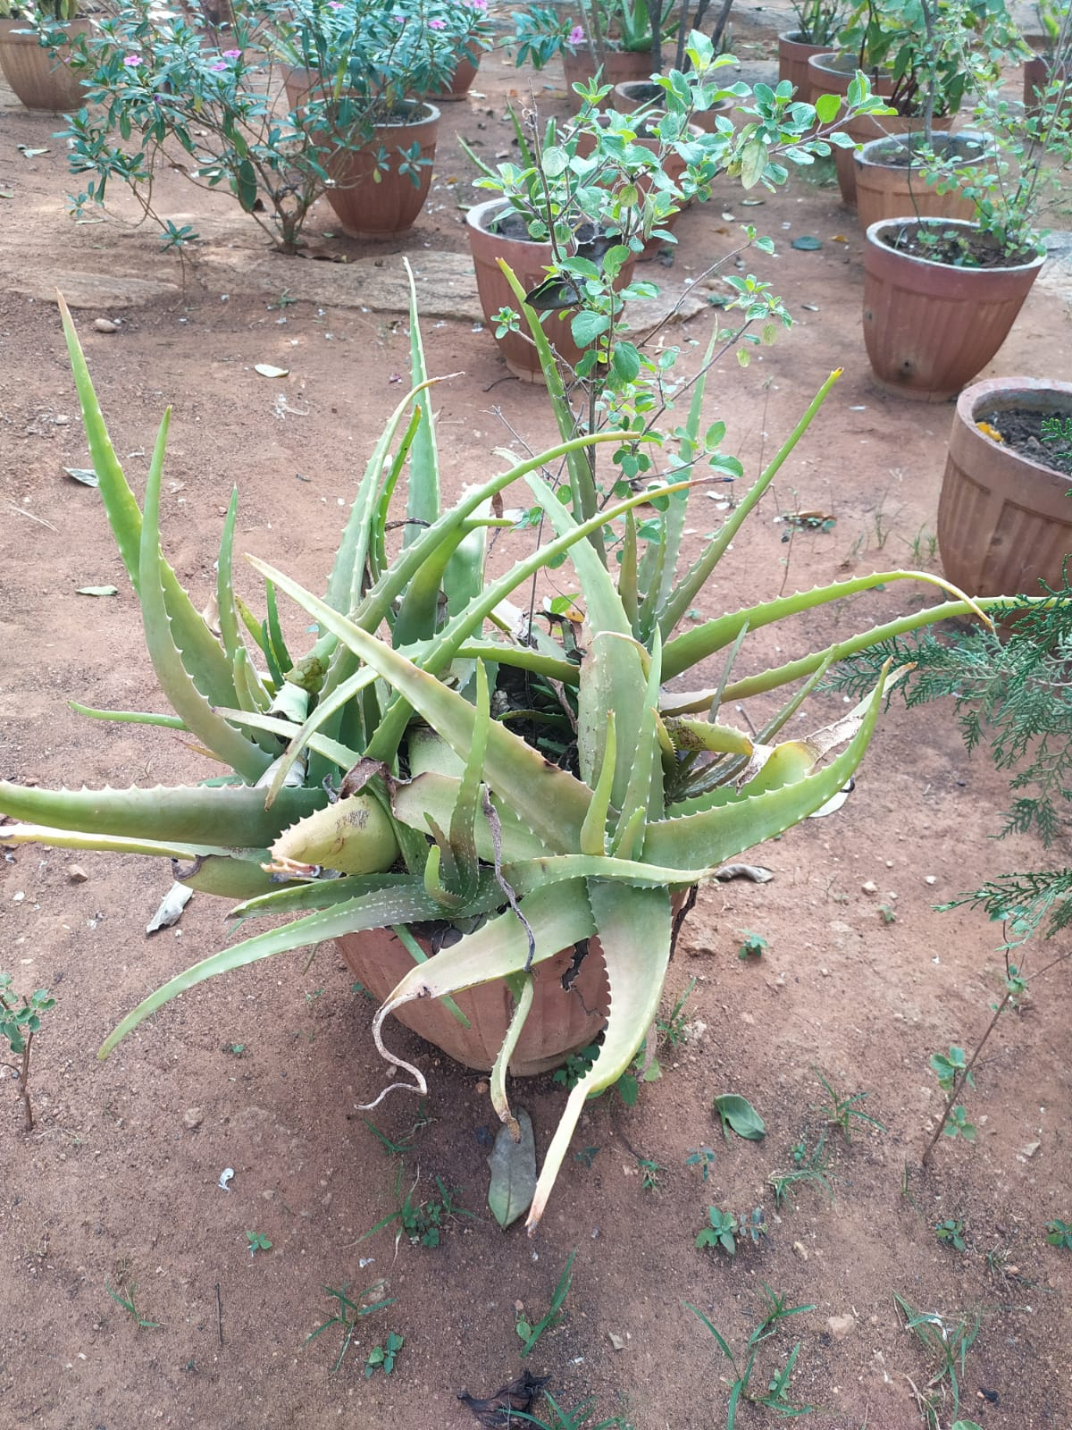
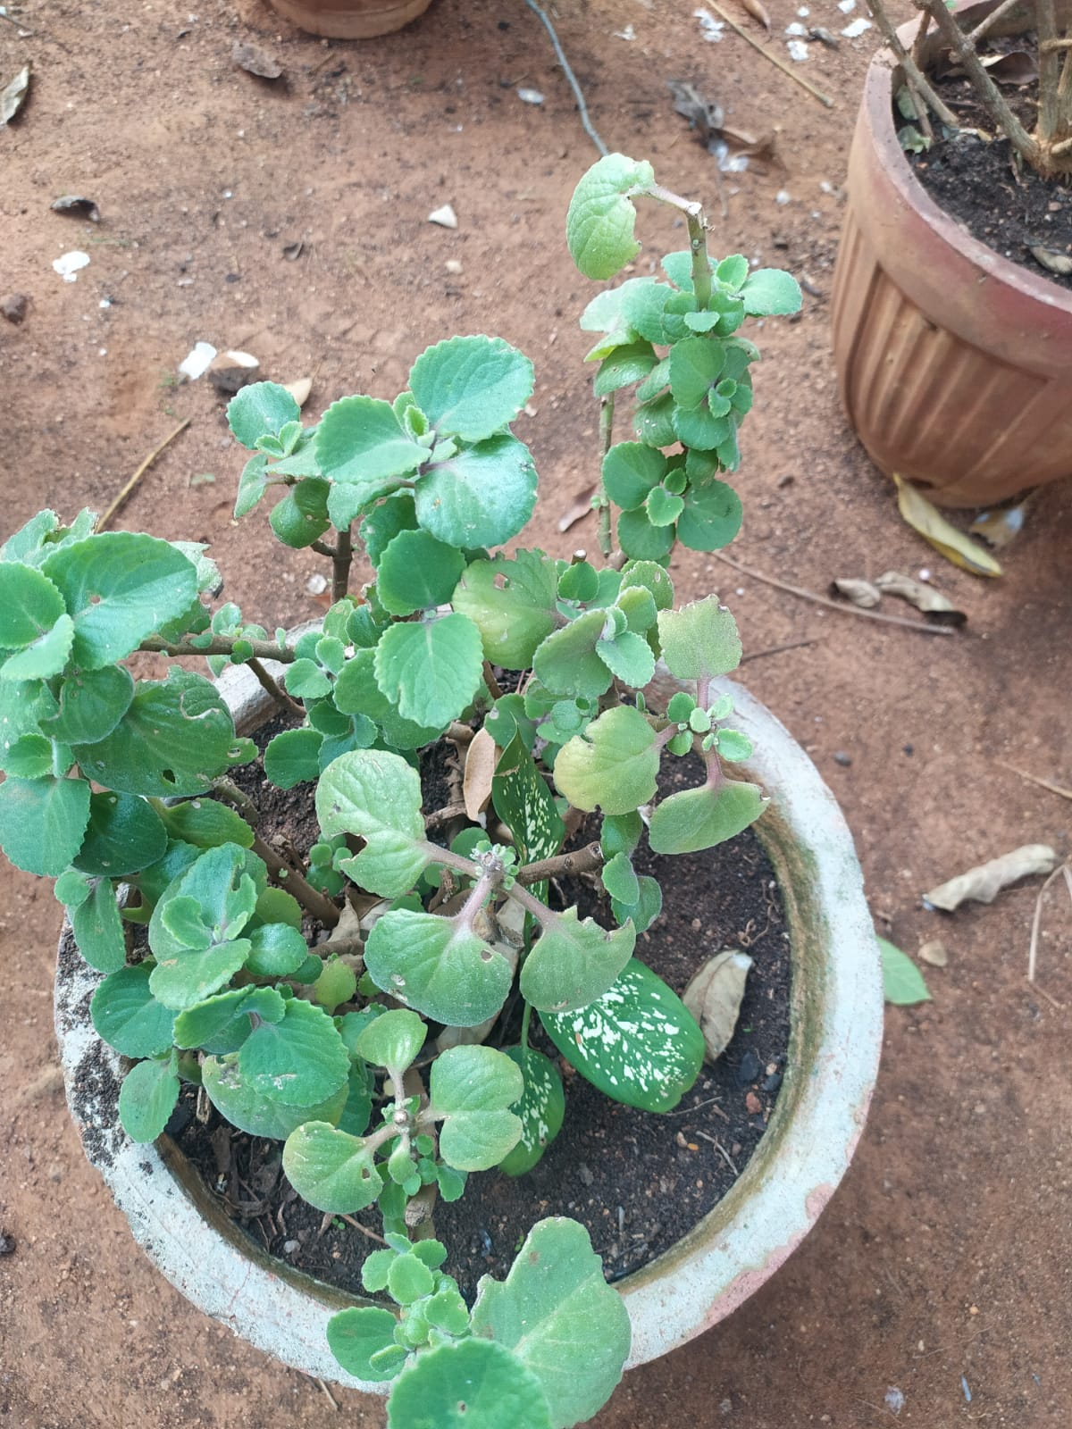
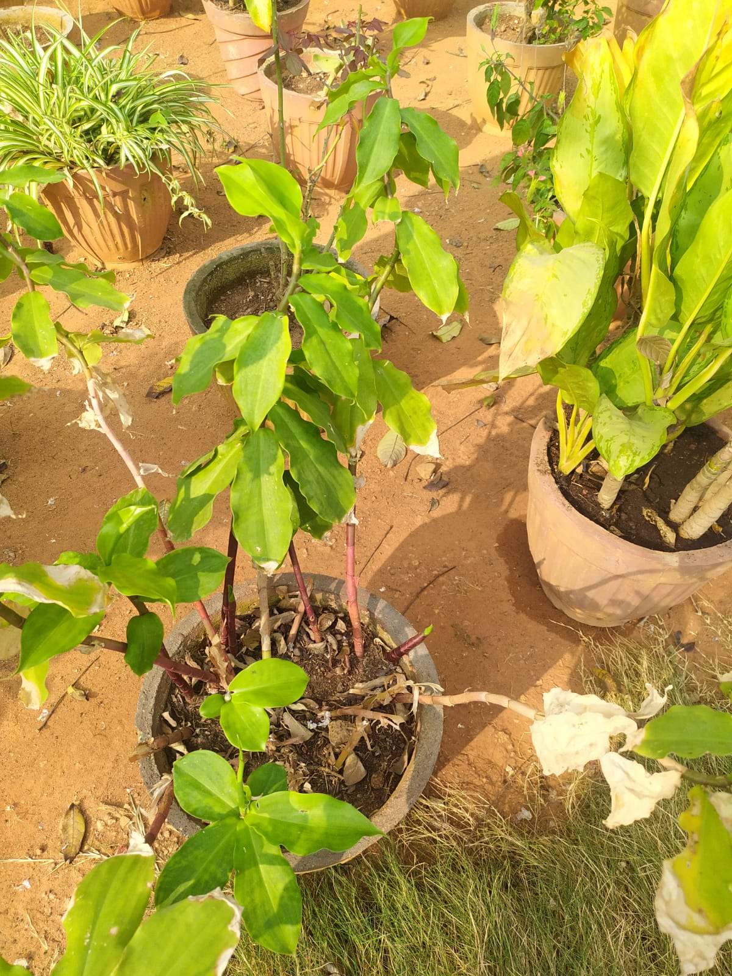
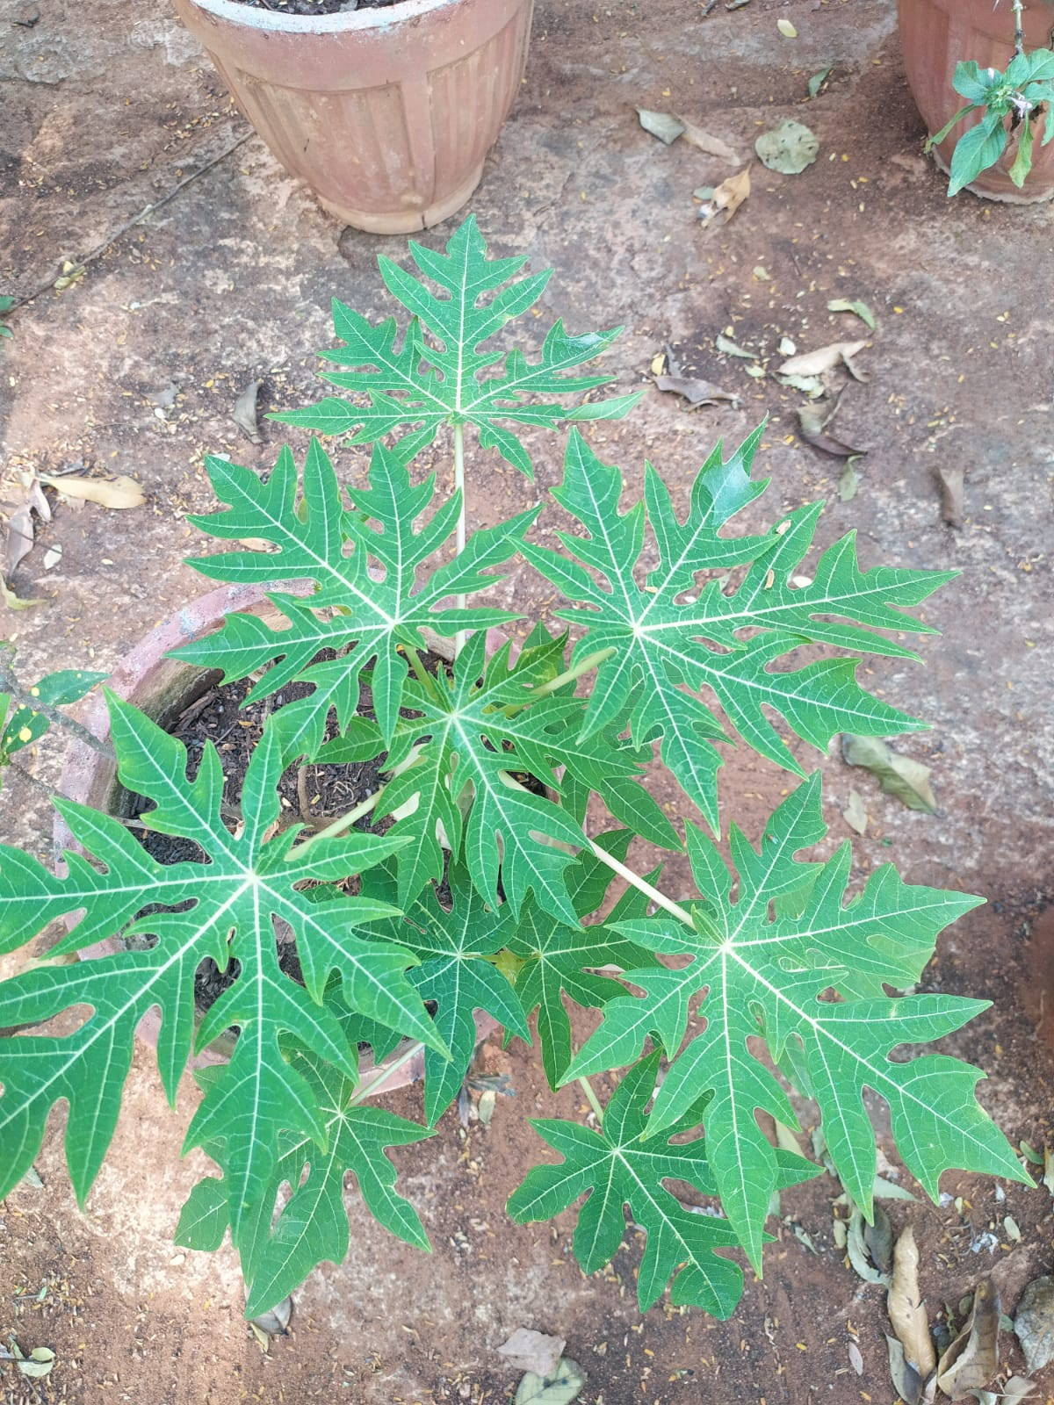
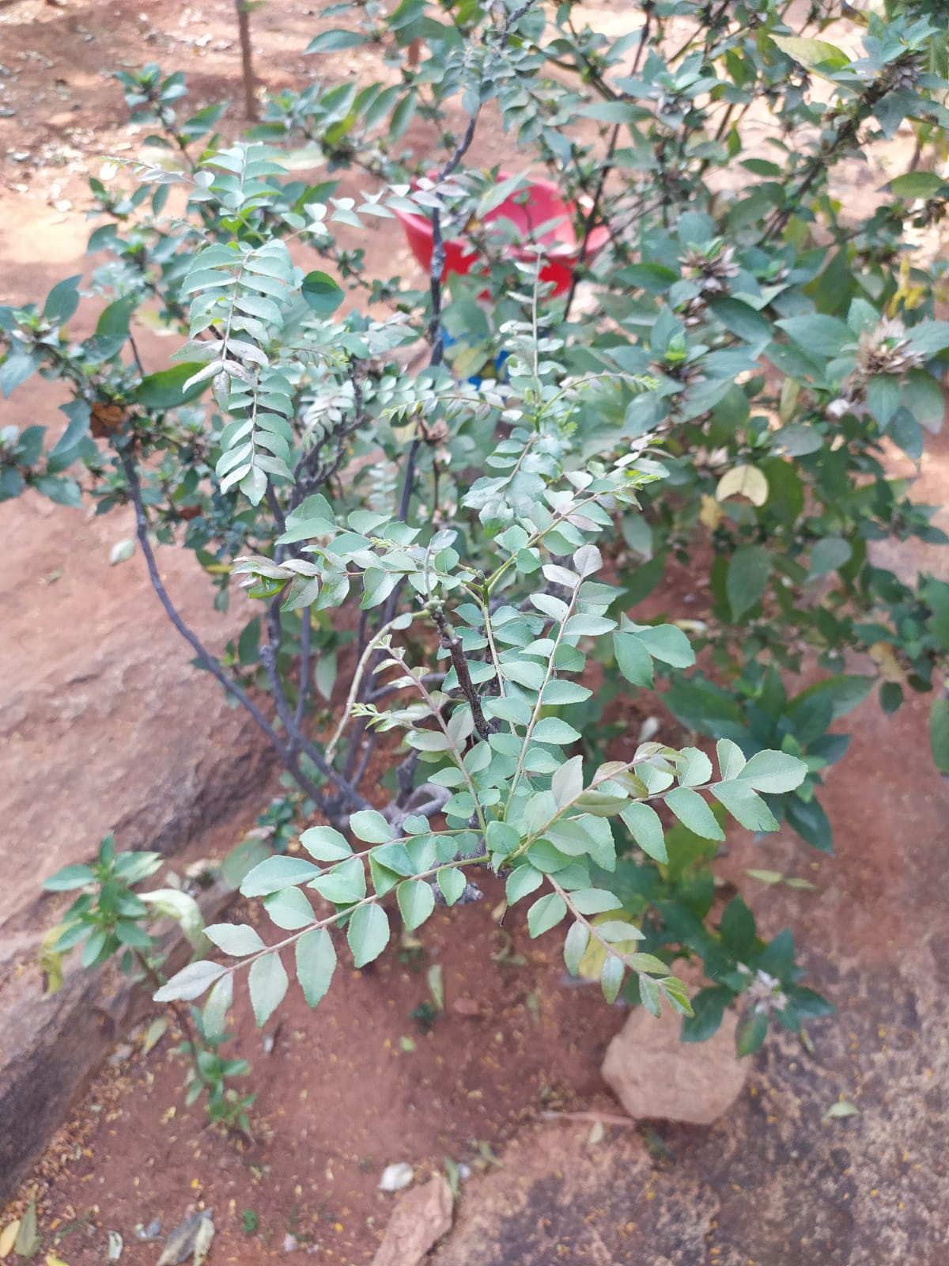

Slide 18
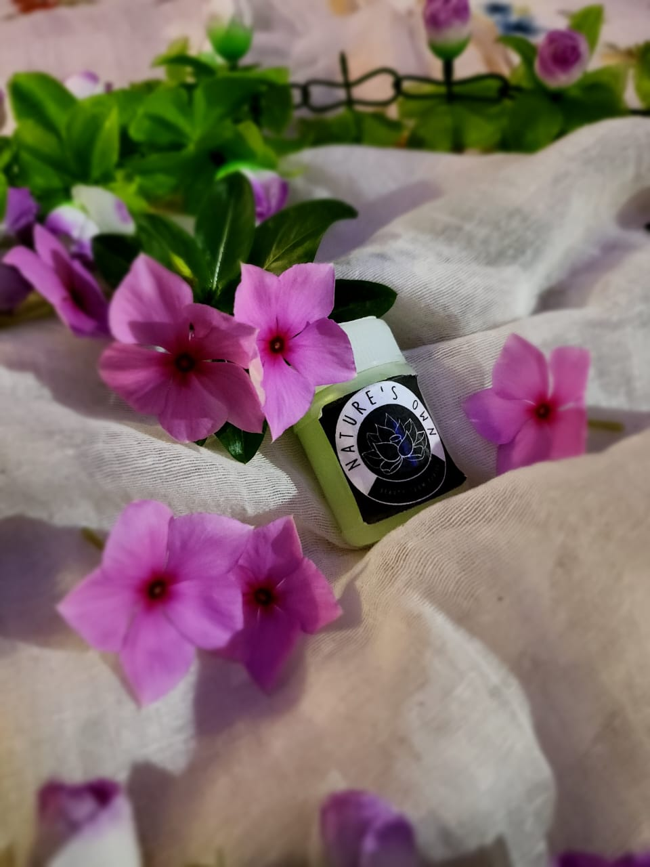
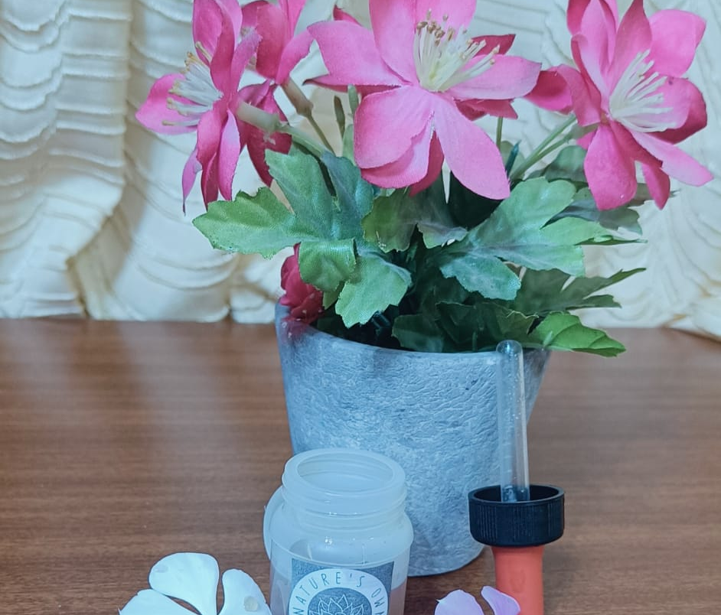
Nature’s own

Slide 19
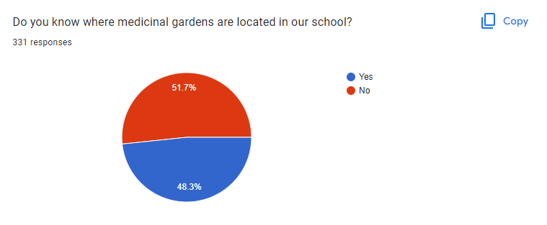
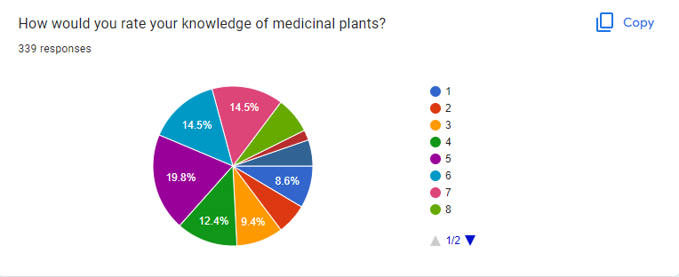
Discussion
ONLINE SURVEY ABOUT PEOPLE’S KNOWLEDGE REGARDING MEDICINAL PLANTS

Slide 20
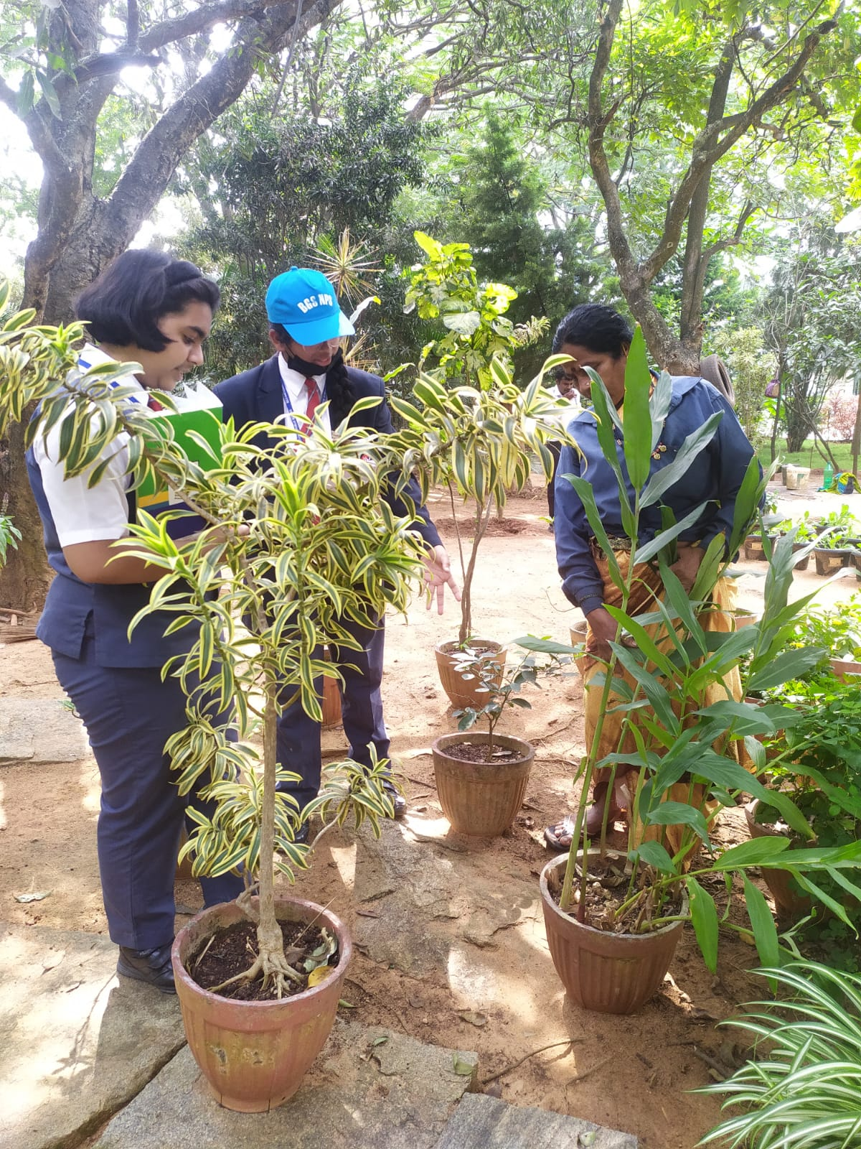
Discussion
OFFLINE SURVEY ABOUT HOW PEOPLE USE THE MEDICINAL BENEFITS OF PLANTS IN THEIR DAILY LIFE
DID YOU KNOW?
Coffee decoction Hibiscus leaves European gooseberry+ Acacia concinna(shikakai) hair mask is used to get strong and healthy hair

Slide 21
Recommendations
“It was a vey good initiative taken by our school students. You can present about it in the science exhibition and all the teachers would surely buy it”- Principal Mam
“Nithya and Tanushree are very enthusiastic students . They are keen observers. They are very talented a would love to learn more about nature”-Ms.Chitralekha C
“It is a very good initiative that you have taken part in this project and learned so much”-Ms.P.Himabindu

Slide 22
Conclusion
After conducting many surveys and learning about the medicinal benefits of plants, we understood that people have very little knowledge including us before we took on with this project. Hence, to increase the knowledge that people have about medicinal plants and their benefits we have created a website where people can shop natural , chemical free, homemade items..
It was a beautiful experience to understand the magnificence of nature and learn about the wonders of it . We hope that you also felt the same while going through our presentation.
Our Website link -https://nithyabalasubraman8.wixsite.com/my-site-1

Slide 23
Acknowledgements
We thank our: Academic Director – S.A Nair
Principal- Smt. Sreekala G Kumar
Vice- Principal- Smt.Savita Suvarna
Co-Ordinator- Ms Smitha Brajesh
Special Thanks to:
Guide- Chirtalekha. C Rajashree

Slide 24
References
Medical plants and uses – Ayush division
Medicinal Plants Team Salubrious Living_E-Magazine_2021-22 - By Team “Salubrious Living”

Slide 25
OUR GROUP
OUR MENTORS
MS.CHITRALEKHA.C
TEAM MATES
NITHYA
TANUSHREE

Slide 26
THANK YOU

